Slide 1
AQUABOTS Aeropak
Final Acceptance Review
Team 26061

Slide 2
Overview
1.0 Introduction
2.0 Post-ISR Changes
3.0 Verification Results
4.0 Lessons Learned & Next Steps
5.0 Budget
6.0 Deliverables
7.0 Summary
Notes:
Jamie

Slide 3
Introduction

Slide 4
Our Team
Jamie Ledbetter, Biosystems Engineering – Team Lead
Robert Wilkie, Aerospace Engineering – Procurement Lead
Alex Imrich, Aerospace Engineering
John Lopez, Electrical Engineering
Mayra Mendoza, Optical Engineering
Kama Henriques, Mechanical Engineering

Slide 5
Project Summary
Purpose: Rapid, real-time environmental monitoring in marine and coastal environments, with control from anywhere in the world. Used in place of sending humans in situations like oil spills, wreckage sites, and more.
Ground Station:
Live video stream from main drone
Real-time environmental data from all drones
GEO-overlay for spatial monitoring and mission control
Hull & Structure:
Self-righting, waterproof, impact-resistant design
Fiberglass enclosure protecting internal systems
Communication:
Starlink satellite antenna for continuous remote connectivity
Onboard Systems:
Jetson Nano – Controls motors, servos, and live video
ESP32 – Collects temperature, pH, and conductivity data
Notes:
Jamie

Slide 6
Post-ISR Changes

Slide 7
Post-ISR Changes
Action Items:
Wiring Concerns
Transient Internal Temperature
Added Servo Mount
Reduction to One Battery
Pixhawk Integration to RC Boats
Replaced ESP32 with ESP32-S3
Tailscale Access
Modified Electronics Shelf
Notes:
Jamie

Slide 8
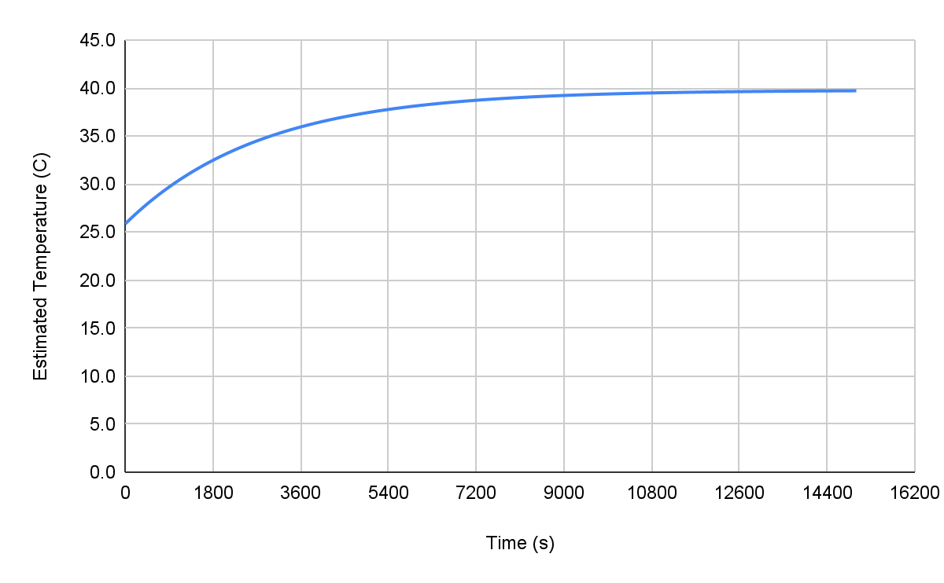
Post-ISR Changes Cont.
Transient Internal Temperature:
Temp. Exponentially approaches steady state at ~39 °C
T(6 mins) ~ 27.5 °C = 81.5 °F
T(30 mins) ~ 32.5 °C = 90.5 °F
T(60 mins) ~ 36.5 °C = 97.7 °F
{
Plot of estimated internal temperature against time.
Notes:
Jamie

Slide 9
 | ISR |  |  | FAR
Branch | Wire (Amp) | Fuse | Status | Wire (Amp) | Fuse | Status
Main Trunk | 4 AWG (135A) | MRBF 150A | ✗ FAIL | 4 AWG (135A) | MRBF 100A | ✓ PASS
ESC / Motor | 8/10 AWG (55A) | MIDI 125A | ✗ FAIL | 8 AWG (73A) | MIDI 60A | ✓ PASS
Starlink | 16 AWG (22A) | ATO 7.5A | ⚠ MARGINAL* | 12 AWG (41A) | ATO 7.5A | ✓ PASS
Jetson 12V | 18 AWG (16A) | ATO 7.5A | ⚠ MARGINAL* | 12 AWG (41A) | ATO 3A | ✓ PASS
Pixhawk PM | 18 AWG (16A) | ATO 1A | ⚠ MARGINAL* | 12 AWG (41A) | ATO 2A | ✓ PASS
ESP32 | 18 AWG (16A) | ATO 1A | ⚠ MARGINAL* | 12 AWG (41A) | ATO 1A | ✓ PASS
BEC / Servo | 18 AWG (16A) | ATO 2A | ⚠ MARGINAL* | 12 AWG (41A) | ATO 2A | ✓ PASS
Data Lines | 22 AWG (~5A) | — | ✓ PASS | 22 AWG (~5A) | — | ✓ PASS
*MARGINAL: Met bare ampacity but had zero derating margin and were mechanically undersized for an enclosed marine hull. Changed to 12 AWG for thermal headroom, vibration resistance, and standardization.
All Action Items Closed

Slide 10
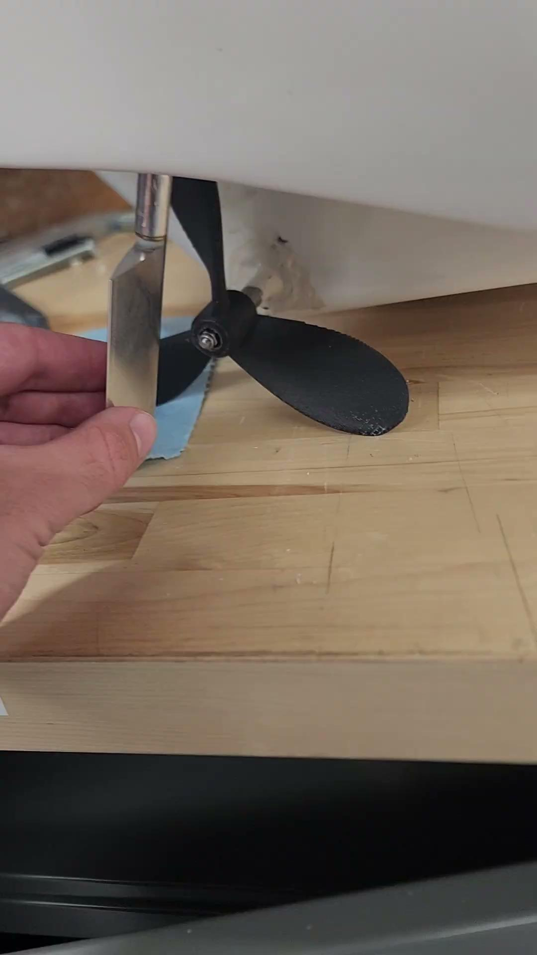
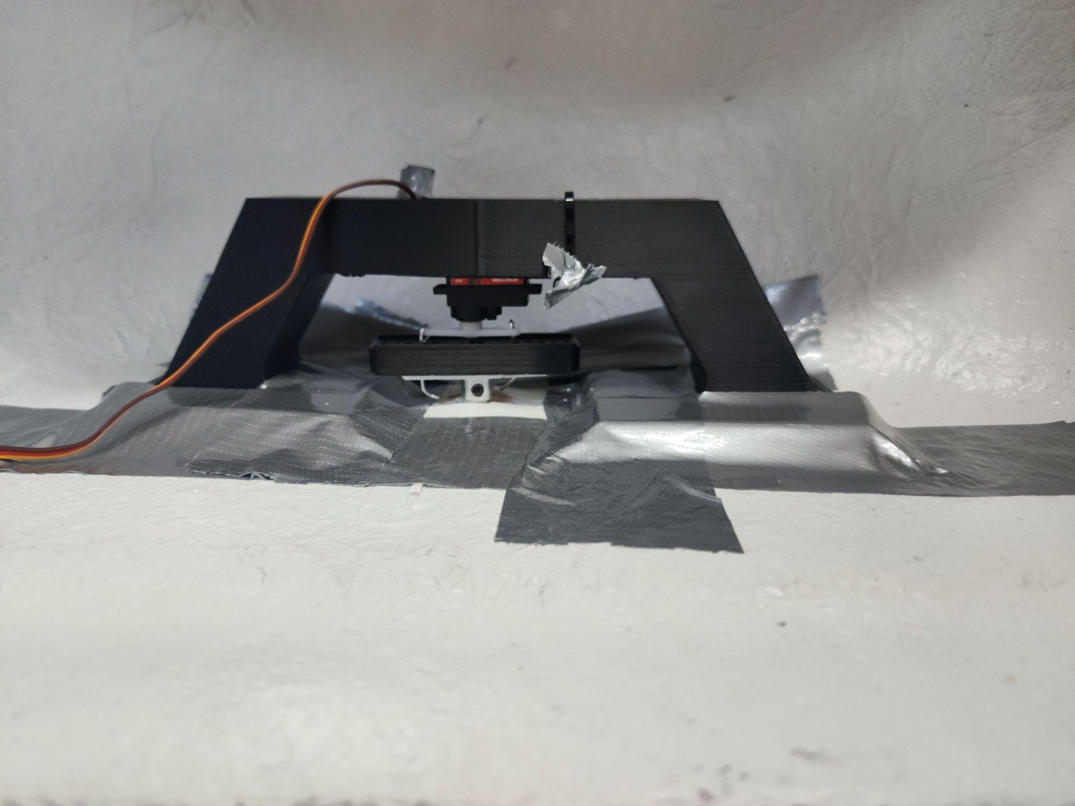
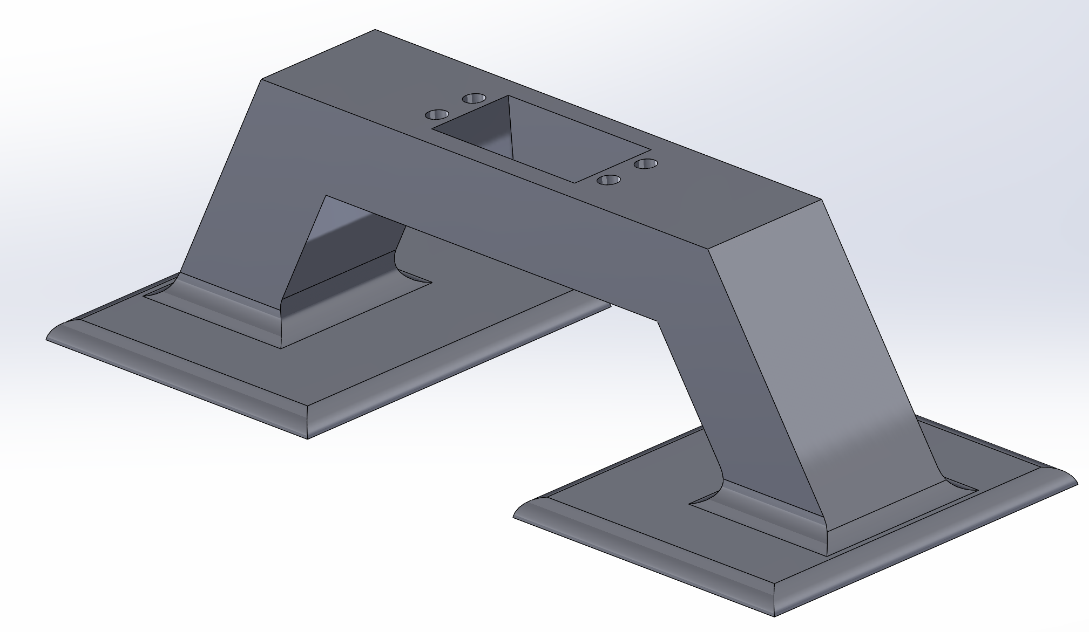
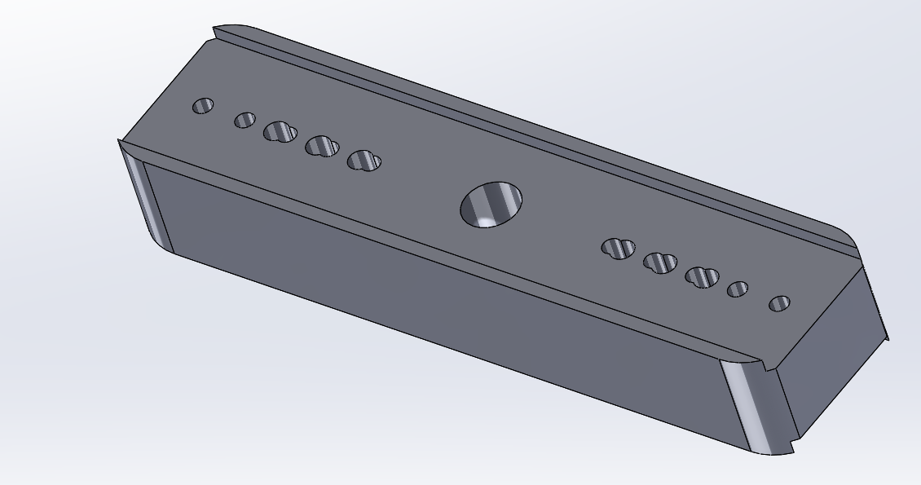
Added Servo Mount for Rudder
Created 3D printed motor mount fastened to hull with strong adhesive (taped for testing)
  Avoids drilling into hull
Will connect servo arm to rudder arm using metal rods and ‘arm adapter’
Notes:
Robert (Include photo of CAD)

Slide 11
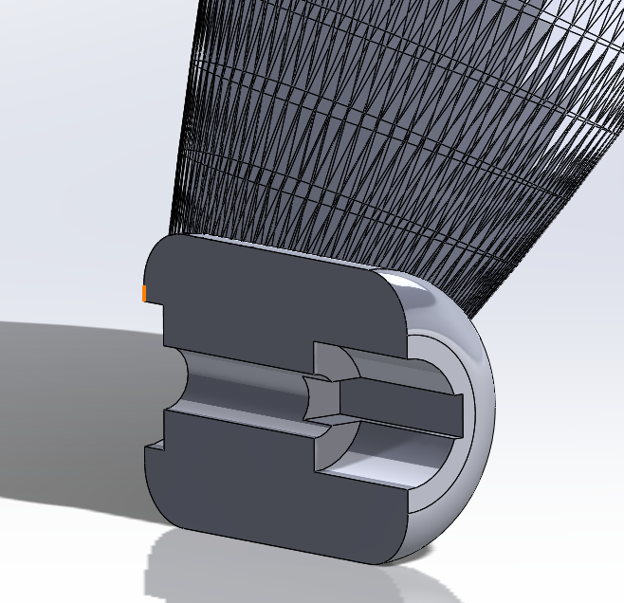
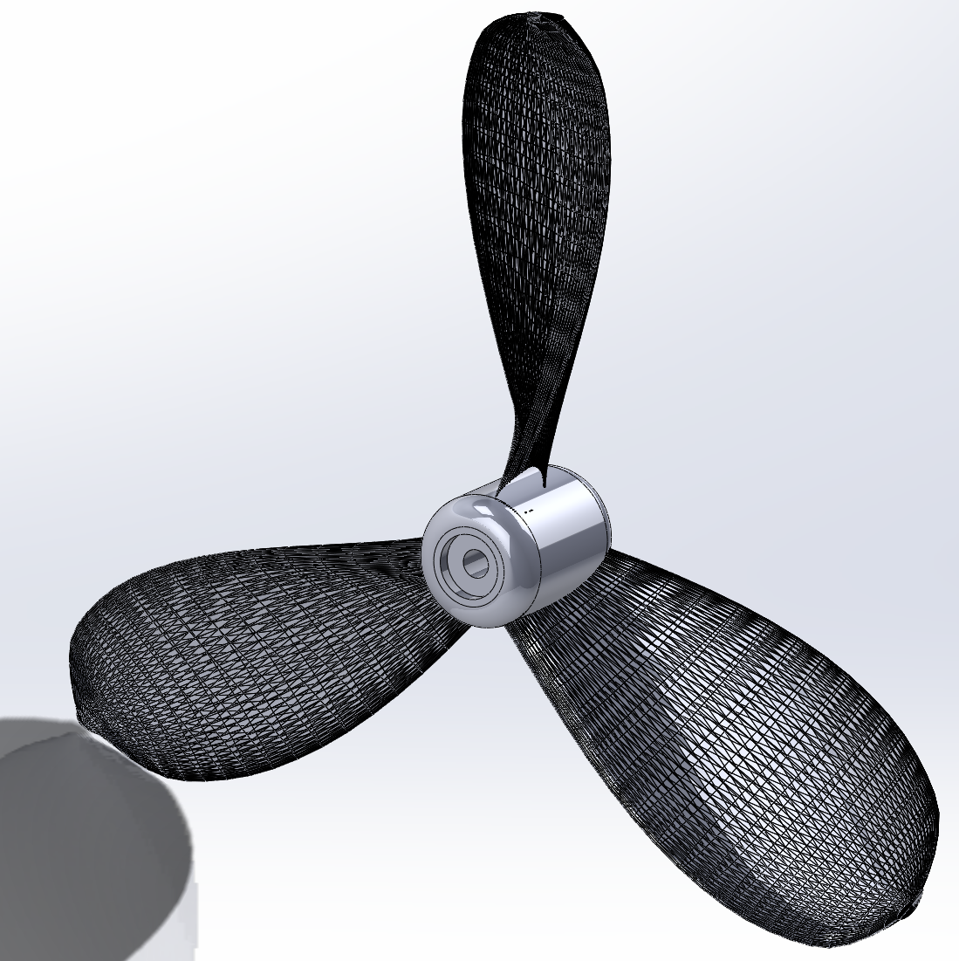
Redesigned Propeller Hub
Very little room on shaft to hold propeller (20mm)
Designed propeller hub to house shaft connection device
  Frees up shaft room so propeller can be larger
Added cut out for retainment nut
  Improves thread engagement
Notes:
Robert (Include photo of CAD)

Slide 12
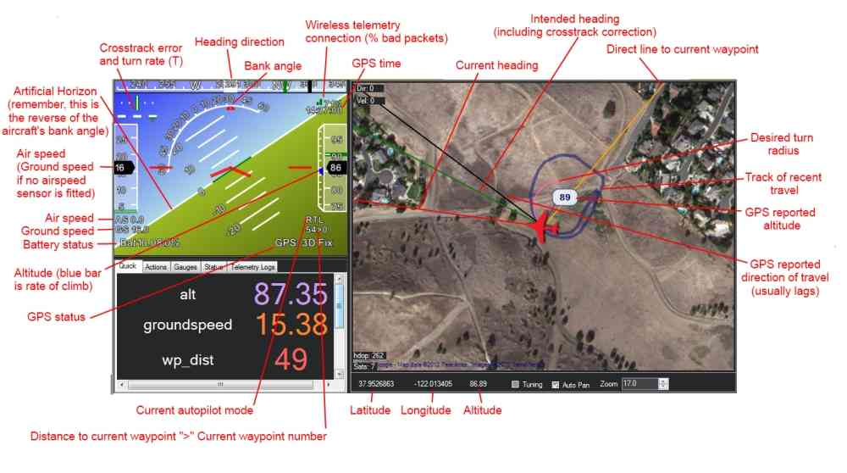
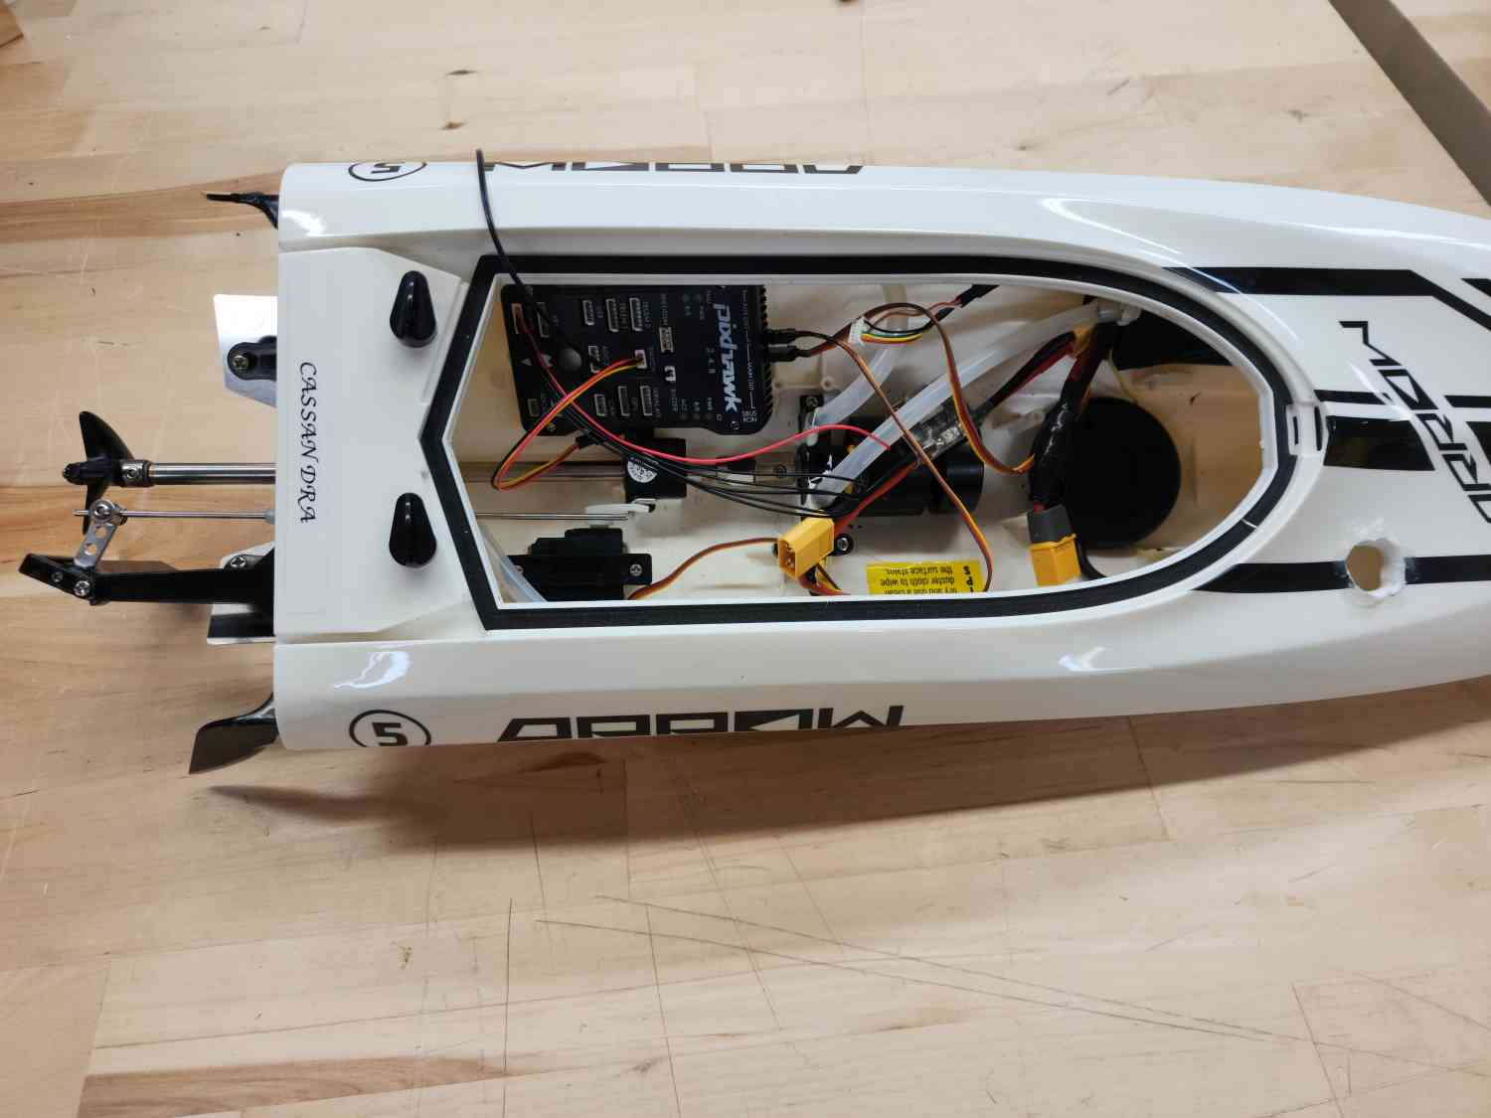
RC Boats
Final Steps of Integration
Pixhawk flight controllers connected - now troubleshooting and ensuring proper connections
Notes:
Alex - addition of pixhawks, include photo of pixhawk, and integration between ESC/Motor/Prop and ESP32.

Slide 13
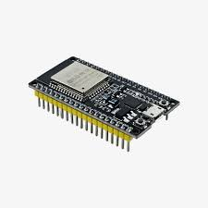
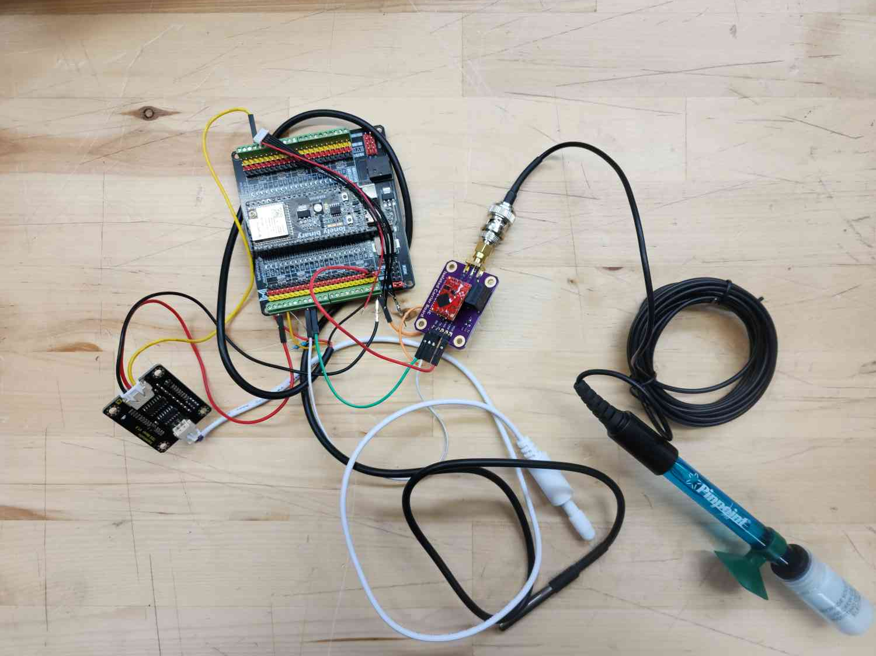
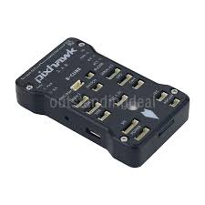
RC Boats
Final Steps of Integration
Pixhawk gives accurate position and orientation
ESP32 → Pixhawk
  Code written, all connections made
Putting everything back in the hulls
Notes:
Alex - addition of pixhawks, include photo of pixhawk, and integration between ESC/Motor/Prop and ESP32.

Slide 14
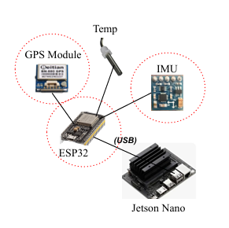
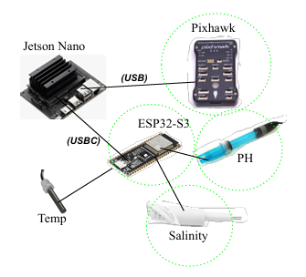
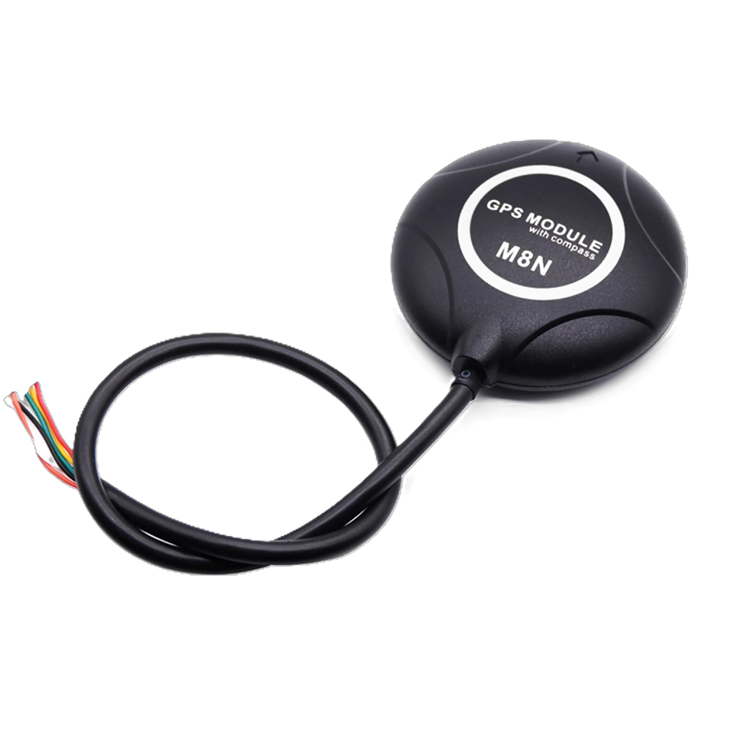
Sensor & Communication Integration (Jetson)
ISR: FAR:
Replaced ESP32 → ESP32‑S3 to support more reliable ESP‑NOW communication for the swarm system
Added Pixhawk to handle motor control, navigation, and sensor timestamping
Integrated final geo‑overlay sensors.
gps
* Main Hull configuration
Notes:
Mayra

Slide 15
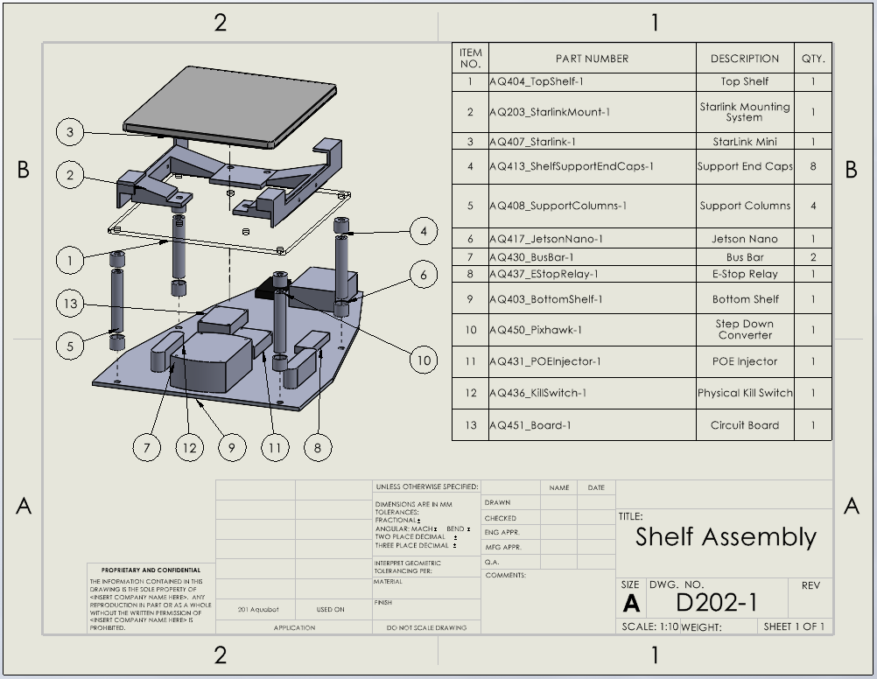
Updated Shelf Subassembly
Notes:
Kama (ISR CAD left → New CAD right)

Slide 16
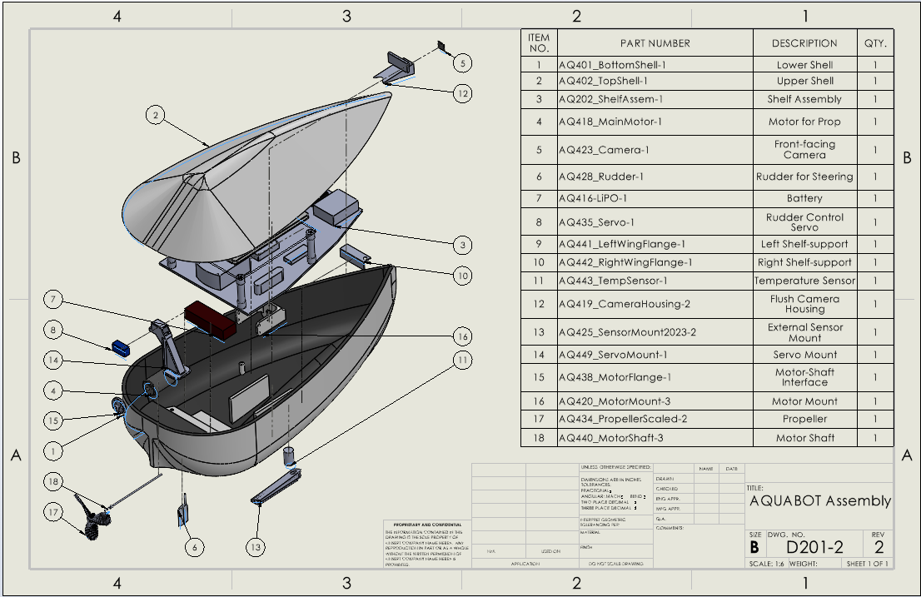
Updated AQUABOT Assembly
Notes:
Kama (ISR CAD left → New CAD right)

Slide 17
Verification Results

Slide 18
Off-Water Navigation/Propulsion Test Setup
Hardware Configuration
Test Objectives
All electronics installed in hull: Jetson Orin Nano, Pixhawk, ESP32, battery
Pixhawk connected to Jetson via MAVProxy (serial → UDP bridge)
GUI hosted on Jetson, accessed remotely via Tailscale VPN
QGroundControl connected over Tailscale for independent telemetry
Verify motor responds to GUI arm + throttle commands (MAVLink RC override)
Verify rudder servo responds to GUI directional commands
Verify waypoint upload and mission state machine transitions
Verify GPS lock and live telemetry display in GUI
Notes:
John - For this test we wanted to verify the full command chain before putting anything in water. Everything is mounted inside the hull. We used MAVProxy to bridge the Pixhawk serial connection to a UDP port so both the GUI and QGroundControl could talk to it simultaneously. Remote access was through Tailscale so the operator doesn't need to be on the same network as the drone. This is the same setup we'd use in the field.

Slide 19
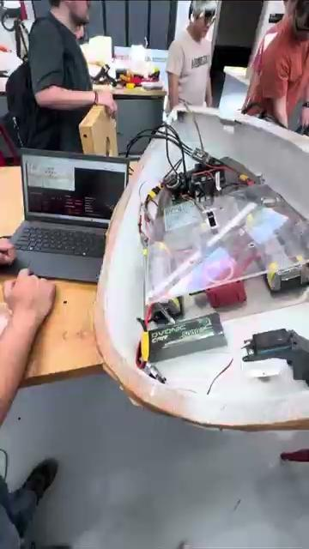
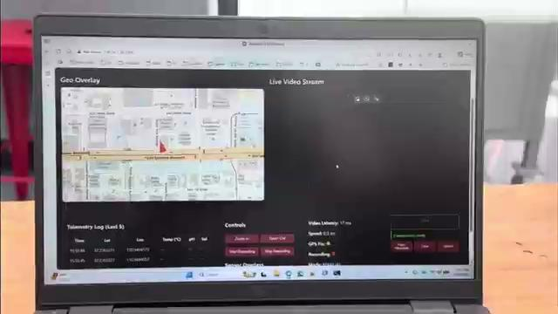
Working Dry-Run

Slide 20
Off-Water Navigation/Propulsion Test — Results
Verified Results
✓ Motor spinning on GUI ARM + throttle (MAVLink RC override)
✓ Rudder servo responding to GUI directional commands
✓ Waypoints uploaded to Pixhawk via GUI mission planner
✓ Mission state machine: idle → uploaded → running → paused
✓ GPS lock; lat, lon, heading, speed live in GUI
✓ Pixhawk status messages forwarded to GUI in real time
✓ Full remote operation via Tailscale (off-site access)
Remaining: In-water speed and maneuverability validation
Notes:
John- All the core command and telemetry paths checked out. Motor spins on throttle command, rudder moves on directional input, waypoints upload cleanly and the mission state machine steps through its phases correctly. GPS was locking and all the telemetry (position, heading, speed,Pixhawk status messages) was showing up live in the GUI. We also confirmed full remote operation over Tailscale from an off-site network. What we didn't do is put it in the water, so in-water speed and maneuverability are still outstanding, so that's the only partial pass here.

Slide 21
Requirements Verified
Requirement | Description | Status | Remaining Action
4.1.3 Stability | Self-righting and orientation | ◐ Partial Pass | Verify With Components
4.1.2 Speed | ≥ 2.5 kts threshold | ◐ Partial Pass | In-water speed run
4.4.1 Autonomy & Control | Autonomous nav + remote control | ◐ Partial Pass | In-water mission execution
5.4.3 Data Relay | Live telemetry to ground station | ✓ Pass | —
Notes:
John - Stability and the sensor display requirements are fully passed. Speed and autonomous navigation are partial passes, the hardware and software are verified, we just haven't done the in-water run to validate actual speed numbers and a live mission. Data relay and display are fully passed with telemetry flowing end to end and showing up correctly in the GUI.

Slide 22
RC Boat Test Setup*
To Accomplish This:
Water Test
  Ensure ALL drone functionality
  Demonstrate Proper Navigation
  Demonstrate Inter-Drone Communication
Tests Needed:
Inter-Drone communication
Proper Navigation
Ensure Total Functionality in a non-workshop environment
Will Verify:
4.4.1 Autonomy and Control
5.4.6 Swarm Control
Notes:
Alex

Slide 23
End to End Remote Operation Test - Setup
System Set up:
Jetson connected to Starlink Network
GUI hosted on Jetson
Tailscale was connected on Jetson.
Remote Access:
Eddy connected to tailscale from Ireland
Opened GUI through browser
http://100.67.1.26
Tested and Recorded:
Live Video Streaming
Real-time telemetry display
Remote control (record button)
Notes:
Mayra

Slide 24

Remote Operation Demo
Remote user (Ireland) successfully accessed and controlled GUI
All sensors integrated and displayed in real time (GPS, IMU, temperature, pH, salinity)
Live video streamed with < 30 ms latency
Remote recording triggered; video and telemetry saved on Jetson
*Eddy sharing his screen through zoom in Ireland
Demo Date : 04/03/2026
Notes:
Mayra - Add video with Eddy, Summarize results in bullet points

Slide 25
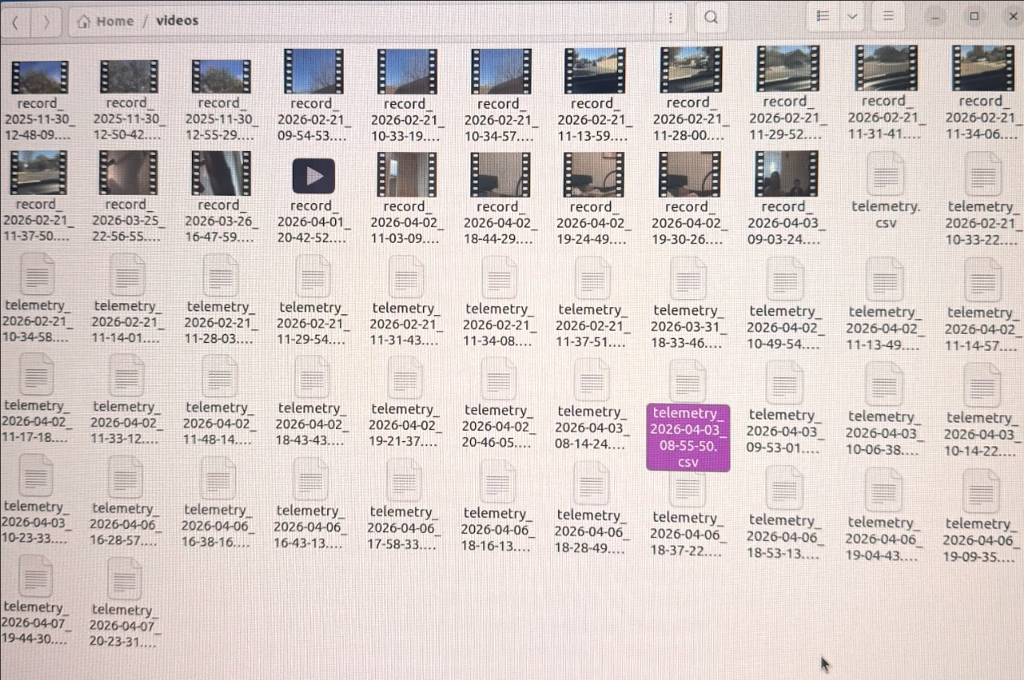
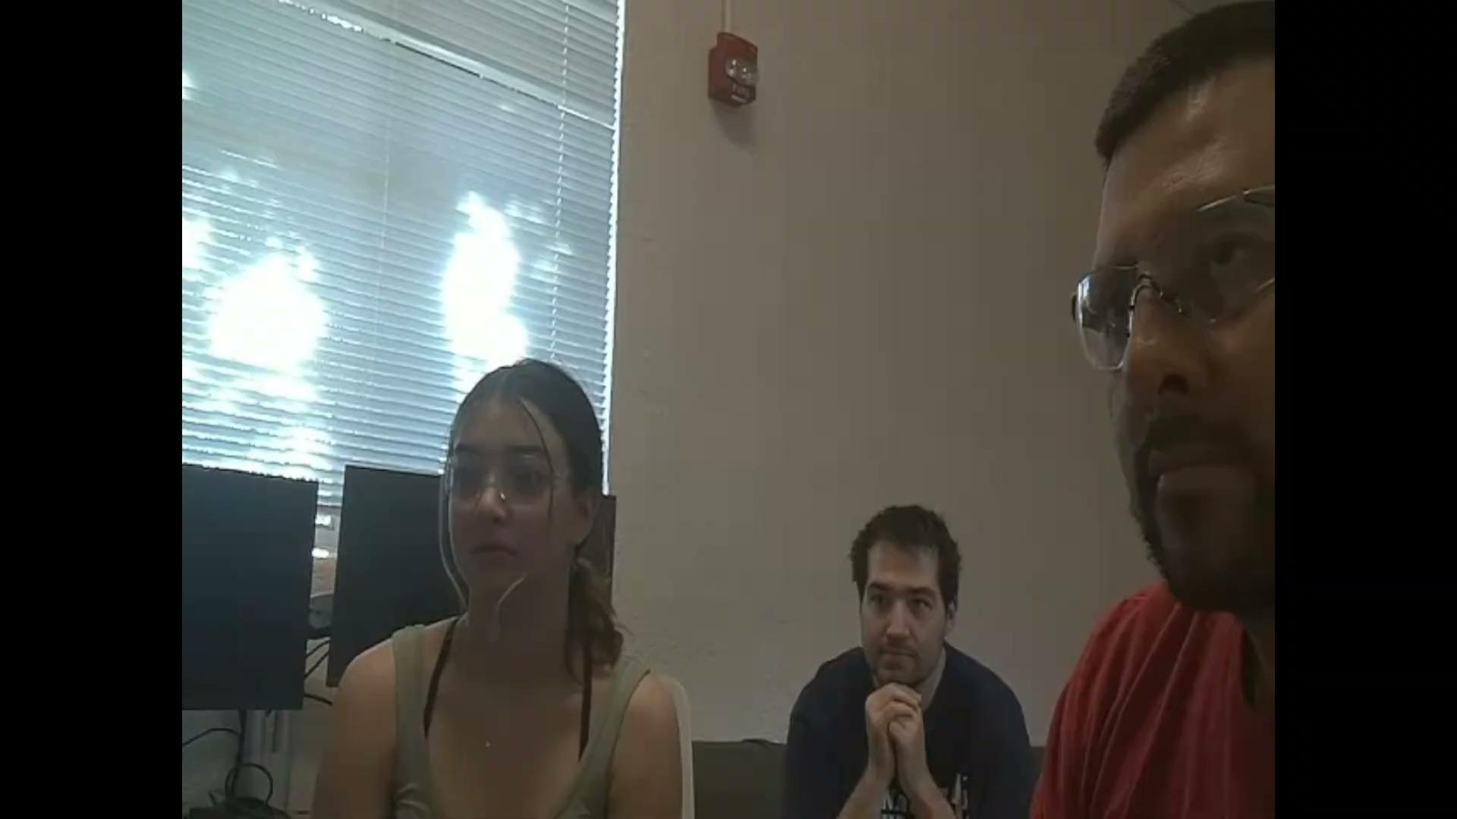
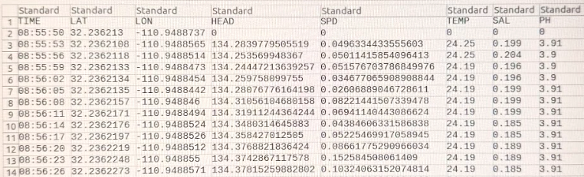
Remote Recording and Data Synchronization
Remote user triggered recording from GUI
Video and telemetry saved on Jetson
Synched and saved under same file.
Confirms end to end remote data collection and control.
* A little discrepancy with time eddy did start recording before camera turne don

Slide 26
Results
Requirement | Status | Remaining Action
5.1.6 Data Collection | Pass | —
5.1.7 Data Mapping | Pass | —
5.4.3 Data Relay | Pass | —
5.4.4 Satellite Uplink | Pass | —
5.4.5 Display | Pass | —
5.4.1 Autonomy & Control | Partial Pass | Validate throttle and waypoint control on-water and remote (Starlink) conditions
Notes:
Mayra - Add in other requirements that have been fully/partially verified

Slide 27
Communication Subsystem Verification - Setup
System Configuration Tested
What Was Verified
Jetson Orin Nano running GUI backend (Flask + WebSocket) + WebRTC video
MAVProxy routing Pixhawk MAVLink to QGC + GUI over Tailscale UDP
Tailscale VPN encrypted tunnel for remote operator access
WebRTC peer connection for live video (IMX219, 1280×720)
ESP-NOW swarm layer (ESP32) verified separately
Command Path
Browser → Tailscale → Jetson → MAVLink → Pixhawk → Motor/Servo
Telemetry Path
Pixhawk → Jetson → WebSocket → GUI (GPS, heading, speed)
Video Path
IMX219 → GStreamer → aiortc → WebRTC → Browser
Notes:
This covers the full communication stack that ties the drone to the ground station. MAVProxy handles the Pixhawk side, it owns the serial port and forwards MAVLink packets to QGroundControl for monitoring and to the GUI backend for telemetry. Tailscale gives us the encrypted tunnel so the operator can be anywhere with internet. WebRTC handles the video and the camera stream is working. The ESP-NOW swarm layer is verified seperately

Slide 28
Communication Subsystem - Results
Requirement | Status | Notes
5.3.1 Survivability | ◐ Partial | 0% packet loss on bench; wave/open water TBD
5.4.3 Data Relay | ✓ Pass | GPS, heading, speed, sensor data live in GUI
4.4.1 Autonomy & Control | ◐ Partial | Commands confirmed; in-water autonomous run pending
5.4.2 Inter-Drone Comms | ✓ Pass | ESP-NOW verified at range
5.4.6 Swarm Control | ◐ Partial | ESP-NOW layer complete; obstacle avoidance coded, pending ultrasonic sensor hardware test
5.4.4 Satellite Uplink | ✓ Pass | Tailscale + Starlink remote access confirmed
5.4.5 Display | ✓ Pass | Live video + telemetry GUI confirmed working
Notes:
The inter-drone communication numbers are good, we verified sub-5 millisecond round trip, zero packet loss, and automatic peer discovery in under 4 seconds on hardware. That's the ESP32-S3 swarm firmware running on actual nodes. Formation control was verified on hardware On February 9th, the line and wedge formations confirmed passing. We just need the physical ultrasonic sensors connected to run the hardware test. The only thing on the swarm side that's genuinely not done is the bridge from the ESP32 swarm into the Jetson mission planner so the ground station GUI can drive it directly.

Slide 29
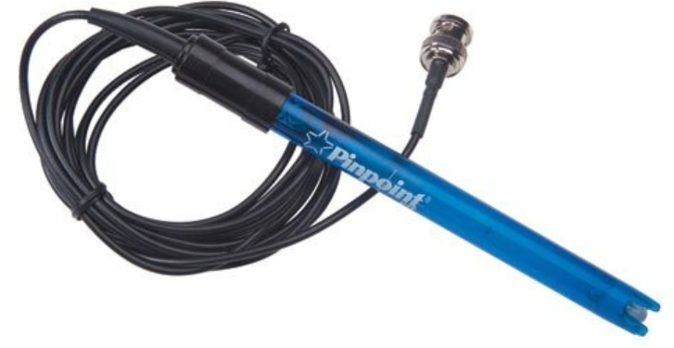
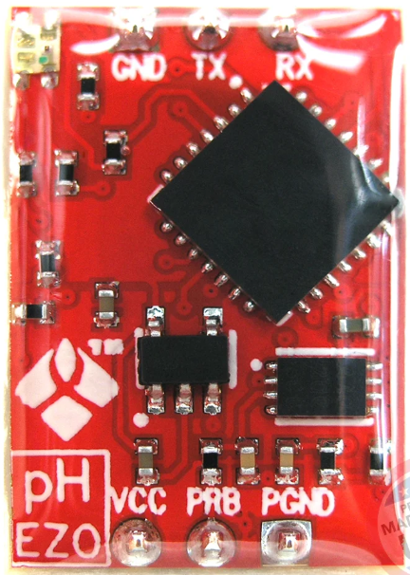
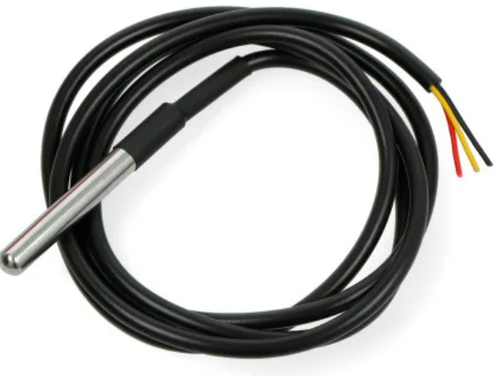
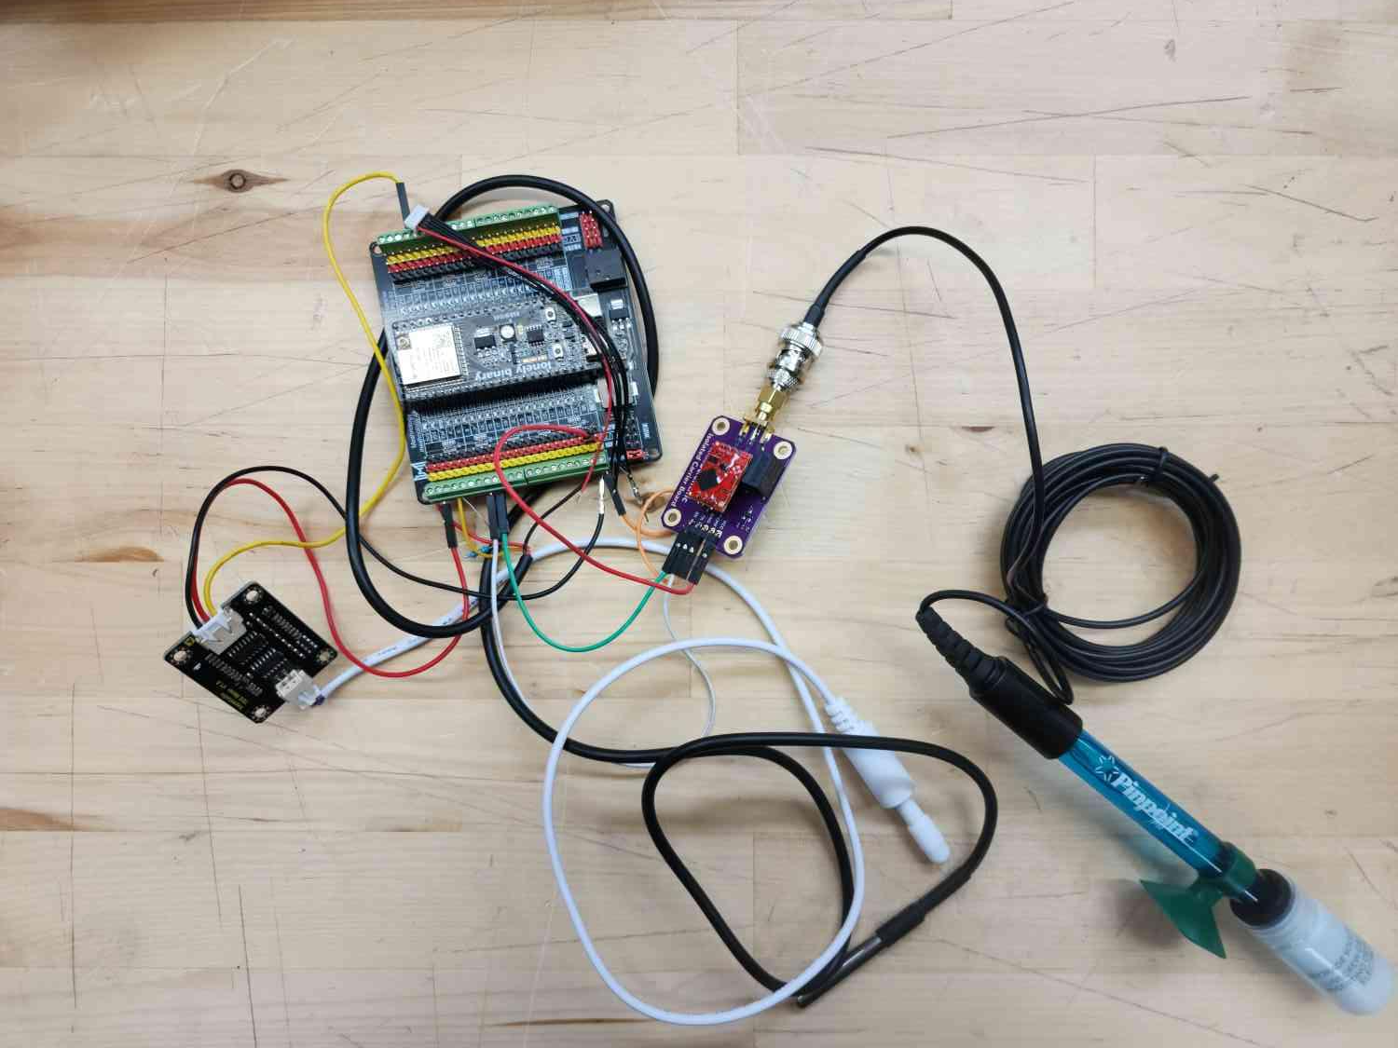
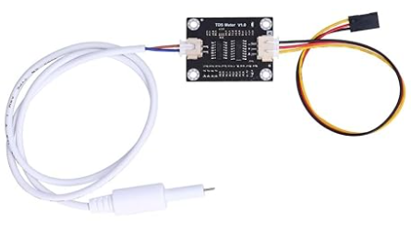
Sensors Verification Plan
pH Probe
CSV File in Format:
Date,Time, Lat., Long., Speed, GPS Fix, Temp., Cond., pH.
Temperature Probe
Conductivity Probe
Notes:
Jamie

Slide 30
Results
Temperature Sensor: Requires slight offset and scaling, tested in two temperatures against a certified liquid-in-glass thermometer (ice water (33°F) warm water (200°F))
pH Sensor: Accurate, did not need calibration. Tested in ph 4. 7, and 11.
Conductivity Sensor: Requires slight scaling. Tested in air and in 1413 S/cm
Requirement | Status | Remaining Action
5.1.6 Data Collection | Pass | None
5.4.5 Display | Pass | None
5.2.4 Payload Mounts | Pass | None
5.3.2 Waterproofing | ◐ Partial | Testing In Motion
Notes:
Jamie

Slide 31
Lessons Learned
& Next Steps

Slide 32
Lessons Learned
Interdisciplinary communication was critical for aligning engineering decisions across subsystems
Early modeling and prototyping helped reduce technical risk and guide design decisions
How to best manage everyone’s work-styles and different approaches
It was important to remain realistic about scope and make tradeoffs based on time and resources
Navigating conflicting client input required balancing requirements with feasibility
Notes:
Kama

Slide 33
Next Steps & Getting to Design Day
Assembly
Finalize sealing of mounts
Secure electronics stack in place
Testing
Water Test 1 (Monday)
Water Test 2 w/ Remote Control from Ireland (Tuesday)
Prepare Design Day Materials/Final Assignments
Video & Imagery
Awards Applications
Poster
Customer Satisfaction Report
Final Report
Notes:
Jamie

Slide 34
Budget

Slide 35
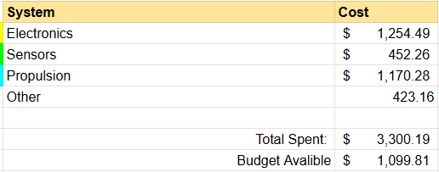
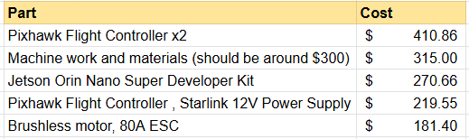
Cost Analysis
Notes:
Robert

Slide 36
Deliverables
Notes:
Jamie

Slide 37
Deliverables
Documentation :
Final Report
Final Technical Data Package (TDP)
System Requirements Document (SRD)
Intermediate Design Reports (CDR, ISR)
All Video Footage and Imagery Pertaining to Design and Results
Software:
All CAD Models
GUI and Tailscale Data Access w/ Starlink
Hardware:
1 Main Drone, 2 Drones for Swarm Demonstration
Main Drone Mold and Additional Model (from previous team)
Replacement and Maintenance Materials
Notes:
Jamie

Slide 38
Summary
Notes:
Jamie

Slide 39
Summary
Overview of Project
Deployable drone to monitor ocean health
  pH, salinity, temperature sensors
Autonomous swarm navigation system
  Controllable from anywhere in the world over Tail Scale
  Waypoint-based movement
  Individual drone selection
Next steps
Communication between main drone and RC boats
Implement Starlink and secure Electronics Stack
Connect Sensors
Testing in aquatic environment
Notes:
Robert - what it does, how we’re gonna finish it

Slide 40
Questions & Discussion
Notes:
17

